Slide 1

Amazon Sales Data Analysis
PRAJVAl MHASKE
prajvalma17@gmail.com

Slide 2
The Process :
Data Collection
Data Cleaning
Data Analysis
Data Visualization
Stimulate Results
Use results in business

Slide 3
Data Collection -
The Data has been collected in the form of a CSV file named “Amazon Sales Data.csv”.
The CSV file has the data of sales of products which consists of total revenue, profits and units sold as per item type

Slide 4
Data Cleaning -
In data no null values were found
Some values in ‘Order Date’ and ‘Ship Date’ columns are in String datatype. So we converted them using excel
Most of the values in ‘Total Revenue’, ‘Total Cost’ and ‘Total Profit’ columns were written with two decimal places, so converted it to whole number by using Excel-ROUNDDOWN() Function.

Slide 5
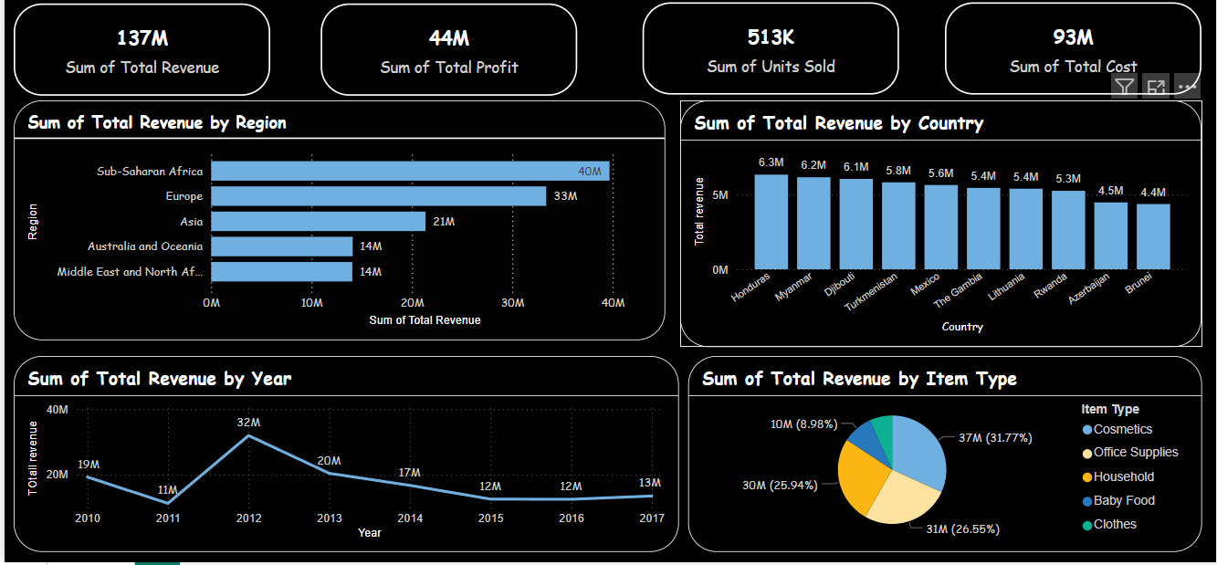
Visualization

Slide 6
Insights -
The total revenue generated during 2010 to 2017 is $137 million out of which total profit is $44 million.
“cosmetics” generates the highest revenue ( 37M )among the categories listed, indicating it is a significant revenue driver for the business.
Majority of people still prefer “Offline Channel” for buying products.
The year 2012 has seen the highest sales which is 32M.
The Sub-Saharan Africa region has seen the highest sales near about 40M.

Slide 7
Summary -
“cosmetics” is leading category which generated the highest revenue among the categories listed, indicating it is a significant revenue driver for the business. There may be strong demand for cosmetics, or it could be a high-margin category, which can be a focal point for marketing and inventory decisions
Fruits represent the smallest revenue segment which is 3.79% only , Snacks and fruits might offer opportunities for growth with appropriate strategies or promotional efforts.
Europe gave high revenue from cosmetics but Asia region gave less compare to it so focus on promotions and understand local needs.
Revenue from “meat” decreased gradually.so it is advisable to promote it by telling its benefits and understand the local needs.
Arrange campaigns on importance of personal care as it offers opportunities for growth .

